Slide 1
Medical Application Example
Group 1
Mingyuan Li (Kevin), Silan Deng (Cyrus), Jaechul Roh (Harry), Hao Dong (Hao Dong)

Slide 2
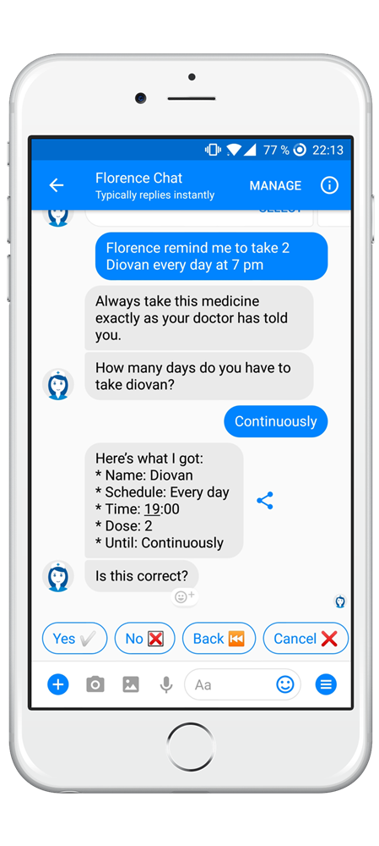
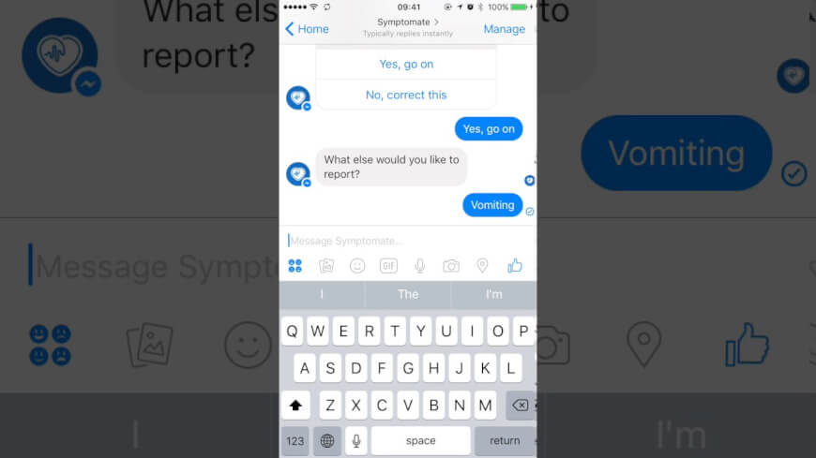
Florence
Infermedica

Slide 3
